Slide 1
Paper Title: Cost-Effective Region-based
Active Learning for Semantic Segmentation
Group members Name and Id:
1. Md Sehabub Zaman Pranta - 1611251042
2. Tanvir Ahmed – 1410982042
3. Jannatul Ferdouse Onny - 1631561042
4. Sadia Ahmed Tandra – 1631474042
5. Rokeya Akanda Sriti- 1620165042

Slide 2
Main Idea
In this work, they proposed a novel cost-effective active learning framework tailored to multi-class semantic segmentation (CEREALS).
The proposed framework reduces the labeling effort by,
1. utilizing spatial estimates about annotation costs inferred from a learned cost prediction CNN and 2. by focusing on image regions promising high information content and low annotation costs in a global context.

Slide 3
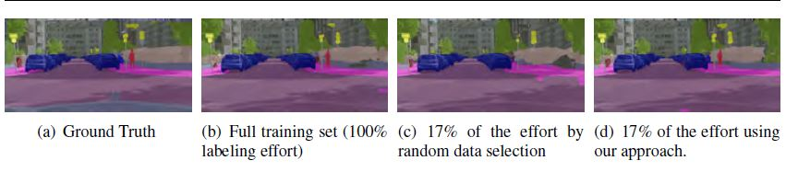
Demonstrating performance

Slide 4
Related Work
1) Pre-training: amount of available ground truth data is relatively scarce.
2) Weakly-supervised learning: annotating a dataset just based on the annotator’s binary decision(if a class is present in an image or not).
3) Semi-supervised learning: a mixture of fine-grained labels plus additional unlabeled data.
4) Synthetic data generation: synthetic images together with highly accurate dense annotations (shortcoming lies in the effort required to generate diverse and realistic sceneries).
5) Interactive segmentation: extracting objects of interest by utilizing sparse user input.
6) Active learning: algorithm can interactively query a user (or some other information source) to label new data points with the desired outputs.

Slide 5
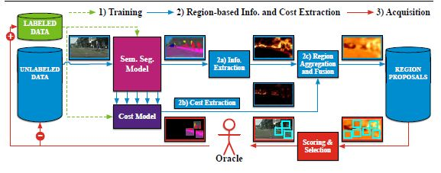
Method

Slide 6
Method Cont'd
1) Training: For constructing the seed set we uniformly sample n images to be fully labeled by an oracle.
2a) Information Extraction: computing information measures for each pixel location individually.
2b) Cost Extraction: approximating costs by the number of clicks necessary to annotate an image.
2c) Region Aggregation and Fusion: some regions could be very costly to label while having only little positive impact on the models performance and vice-versa. They linearly scaled region information maps and region cost maps w.r.t. the whole dataset, such that all values are in [0;1].
3) Acquisition: From the region proposal pool extracted as many top scoring regions as would correspond to extracting m images out of a pool of equally sized images regarding their amount of pixels for a fair comparison to the image-based acquisition of labels.

Slide 7
Results
All processed experiments presented in this work are repeated five times and we report the average mean Intersection over Union (mIoU) calculated on the validation dataset of Cityscapes after training convergences.
After 21 acquisition steps corresponding to 35.29% of queried labels by using entropy sampling, we achieve 95% of the performance as compared to the obtained result of 0.605, when training on the full training set of Cityscapes.

